Slide 1
Orbit fitting using linear maps
Dawit Yerdea
Aug 19,2025

Slide 2
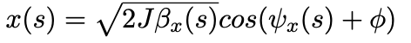
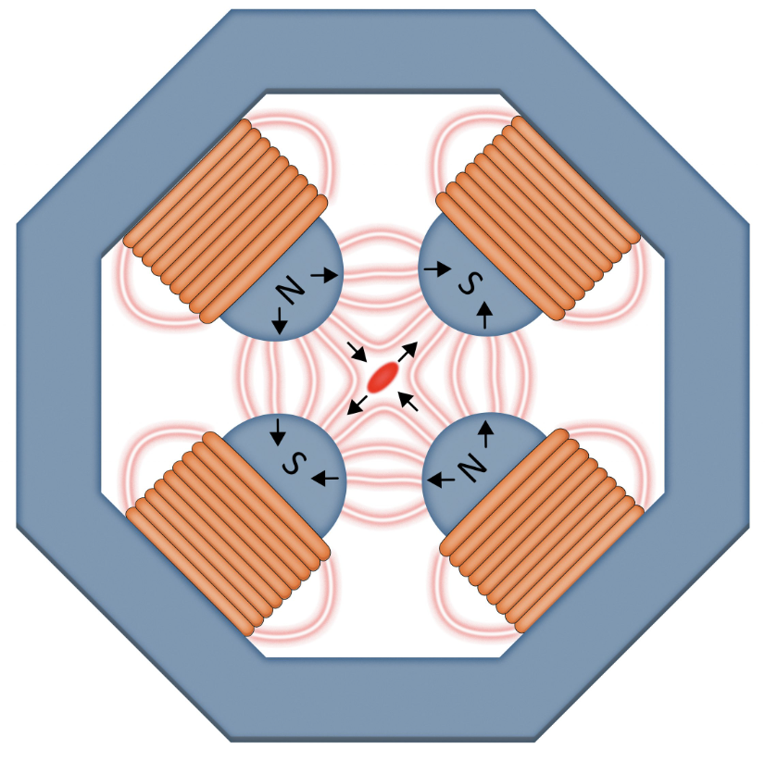
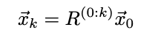
Problem statement
e- beam undergoes stable oscillations when travelling off-center through lattice quadrupoles, called betatron oscillations
can model linear beam dynamics with matrix formalism called R matrices
Get X/Y beam position readings from BPMs along the linac
Use R-matrices (from Bmad model) for relative BPM to BPM transport
goal is to find best fit trajectory to BPM data
Image: Jerald Pinson
FACET-II

Slide 3
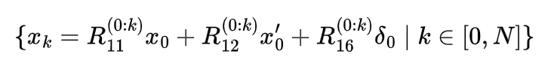
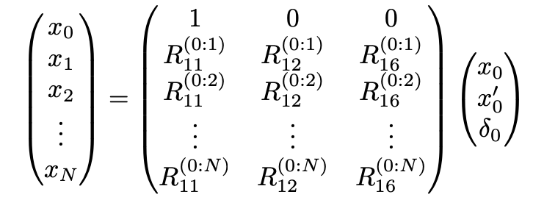
Formalism
Under no coupling assumption, each downstream BPM reading satisfies:
Stacking equation into Matrix form
3 unknown & many known, solve this using Ordinary Least Square method
Now, this equation is usually overdetermined and This gives the best fit initial conditions that explains all the BPM reading, we can reconstruct the orbit by propagating x0 downstream
FACET_II

Slide 4
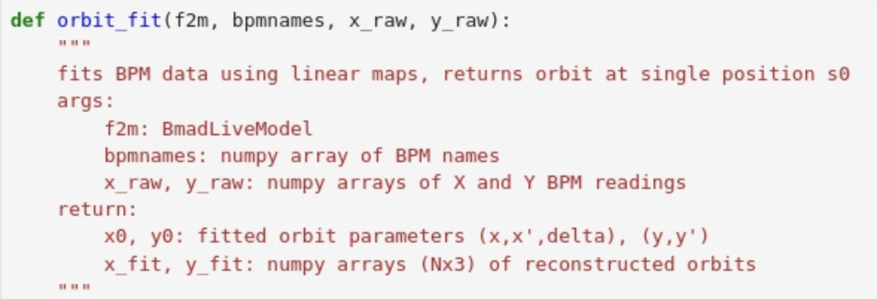
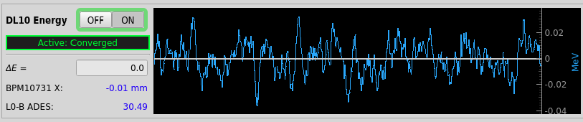
Implementation
I used python code (using live model to get rmats & orbit_fit functions)
Testing (loaded old orbits, performance test)
loaded archived orbits then sanity checks on units and paths
run batch across injector orbits used for DL10 energy feedback measurement
[ 'BPM10511', 'BPM10525', 'BPM10581', 'BPM10631', 'BPM10651', 'BPM10731',]
Operational use case: feedback energy measurement
need to distinguish betatron orbit part (x) from dispersion orbit part (delta)
plot from beam-based feedback GUI, shows the energy measurement vs time
FACET-II

Slide 5
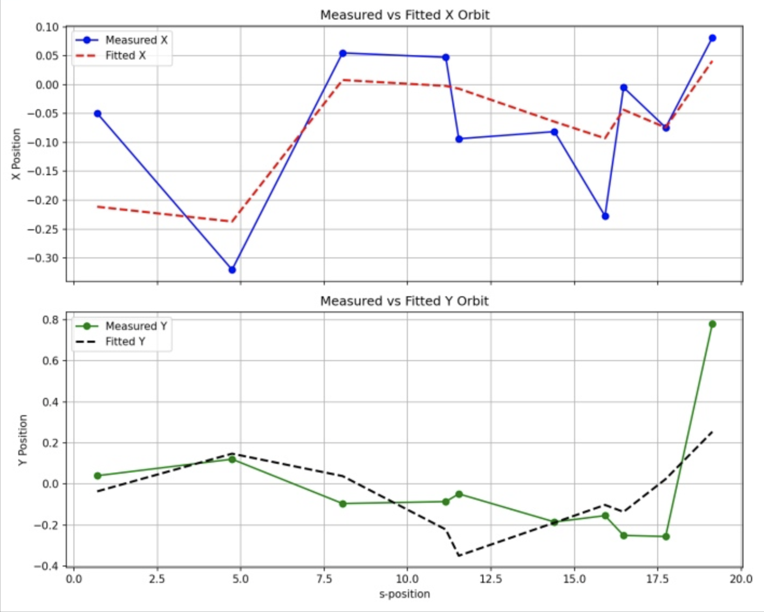
Results
performance (1.5ms -> sufficient for feedbacks, which want <50ms) & stability

Slide 6
Questions?
Thank You
FACET-II

